Slide 1



SRINIVAS INSTITUTE OF TECHNOLOGY
SRINIVAS INSTITUTE OF TECHNOLOGY
Dr A. Raghavendra Rao-COE PROGRAM
MACHINE LEARNING
Dr A. Raghavendra Rao-COE PROGRAM
MACHINE LEARNING
SRINIVAS INSTITUTE OF TECHNOLOGY
Department of Artificial Intelligence & Data Science
Department of Computer Science & Engineering
(NAAC ACCREDITED, AFFILIATED TO VTU, BELGAVI AND RECOGNIZED BY THE AICTE, NEW DELHI)
2022-2023
Department of Artificial Intelligence & Data Science
Department of Computer Science & Engineering
(NAAC ACCREDITED, AFFILIATED TO VTU, BELGAVI AND RECOGNIZED BY THE AICTE, NEW DELHI)
2022-2023
Presented By:
1. Pranaw Kumar- 4SN21CS072
2. Sampad C G- 4SN21CS082
3. Sharat Rama Gouda- 4SN21CS090
4. Sharath H K- 4SN21CS091
Mentor Name: Greeshma VS
Semester: 4th
Presented By:
1. Gagan Deep – 4SN21AD019
2. Chethan P P - 4SN21AD012
3. Snehit Krishna - 4SN21CS101
4. Madan Raikar - 4SN21CS049
Mentor Name: Greeshma VS
Semester: 4th
COURSE : MACHINE LEARNING TRAINER : MS. GREESHMA V S

Slide 2
SRINIVAS INSTITUTE OF TECHNOLOGY
Dr A. Raghavendra Rao-COE PROGRAM
MACHINE LEARNING
T O P I C :
Department of Artificial Intelligence & Data Science
Department of Computer Science & Engineering
(NAAC ACCREDITED, AFFILIATED TO VTU, BELGAVI AND RECOGNIZED BY THE AICTE, NEW DELHI)
2022-2023
UBER – FARE PRICE PREDICTOR
Presented By:
1. Gagan Deep – 4SN21AD019
2. Chethan P P - 4SN21AD012
3. Snehit Krishna - 4SN21CS101
4. Madan Raikar - 4SN21CS049
Mentor Name: Greeshma VS
Semester: 4th

Slide 3
T O P I C :
M A C H I N E L E A R N I N G
UBER – FARE PRICE PREDICTOR
S K I L L – L A B

Slide 4
T O P I C :
Gagan Deep
Chethan P P
Madan Raikar
Snehit Krishna
Team Members:
PALINDROME NUMBER
T O P I C :
UBER – FARE PRICE PREDICTOR

Slide 5
Description:
Gagan Deep
Chethan P P
Madan Raikar
Snehit Krishna
Team Members:
Uber is one of the world's largest ridesharing company, providing millions of rides to customers daily. In this project, we will analyze Uber's historical transactional data to build a model to predict ride fares.

Slide 6


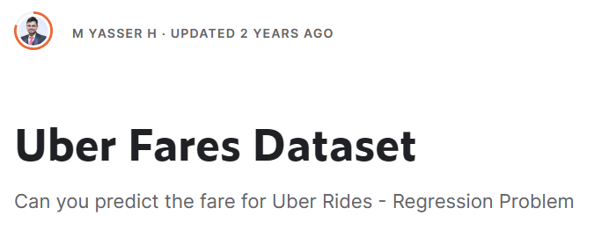
Goal: 🎯
Our goal is to identify key features that correlate with ride fares and build a model to predict fare prices. We will train algorithms on this data to create a robust fare price prediction system.

Slide 7
P R O G R A M
Brief Idea on the Program:
Definition of Palindrome : A palindromic number is a number that remains the same when its digits are reversed.
The C++ Program must be able to identify whether the given number is a Palindrome Number or Not !

Slide 8
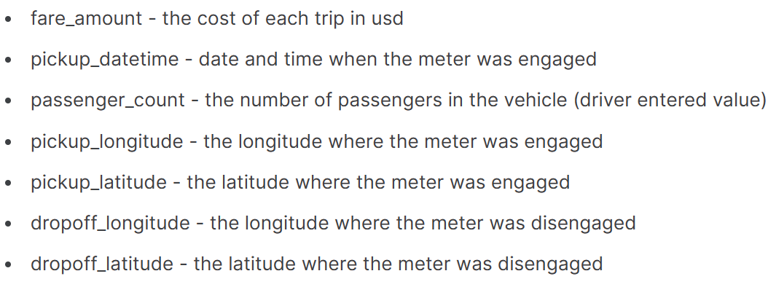
Fields:
UNDERSTANDING THE DATASET

Slide 9

Fields:
The dataset consists of 2,00,000 rows and 9 columns

Slide 10
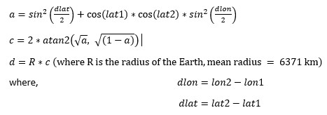

Using Latitudes and Longitudes of two locations, we can calculate the distance using the formula:
Fields:
With this, a new field ‘distance travelled’ is computed.

Slide 11

Caveats Found in the Dataset:
Fields:
Null Values in the dataset are Zeroes.
We can compute ‘Fare Per Km’ and ‘Fare/Km per Person’ to understand and visualize the data in hand:
Fare Per Km = Fare Amount / Distance Travelled
Fare/Km Per Person = Fare Per Km/ Passenger Count
According to the data, uber transactions has occurred at 0 Latitude and Longitude, which is incorrect.
We have replaced zeroes with null values.

Slide 12
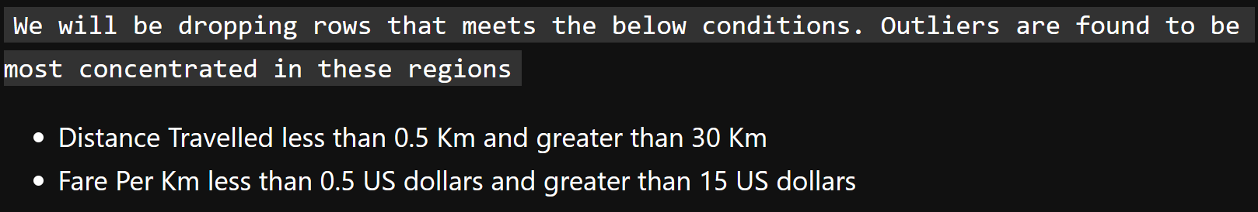


Caveats Found in the Dataset:
Null Values in the dataset are Zeroes.
According to the data, uber transactions has occurred at 0 Latitude and Longitude, which is incorrect.
We have replaced zeroes with null values.
In order to build a model that is accurate, we need to deal with the outliers and anomalies found in the dataset.
Upon analyzing the dataset:
Fields:
We can compute ‘Fare Per Km’ and ‘Fare/Km per Person’ to understand and visualize the data in hand:
Fare Per Km = Fare Amount / Distance Travelled
Fare/Km Per Person = Fare Per Km/ Passenger Count

Slide 13
In order to build a model that is accurate, we need to deal with the outliers and anomalies found in the dataset.
Upon analyzing the dataset:
Fields:
We can compute ‘Fare Per Km’ and ‘Fare/Km per Person’ to understand and visualize the data in hand:
Fare Per Km = Fare Amount / Distance Travelled
Fare/Km Per Person = Fare Per Km/ Passenger Count
I N S I G H T S

Slide 14
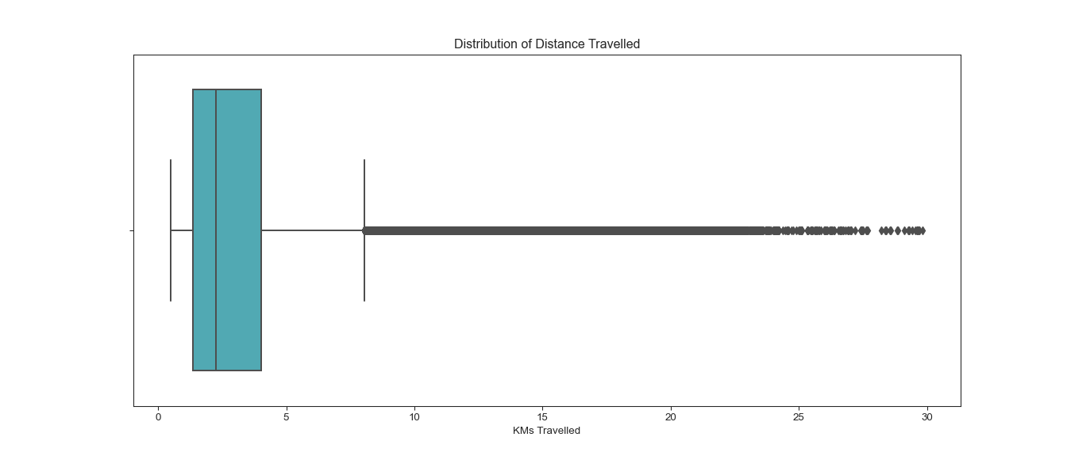
In order to build a model that is accurate, we need to deal with the outliers and anomalies found in the dataset.
Upon analyzing the dataset:
I N S I G H T S

Slide 15
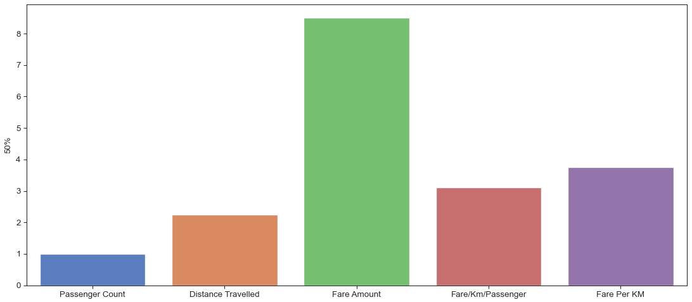
I N S I G H T S
Data Distribution Across Distance Travelled Field

Slide 16
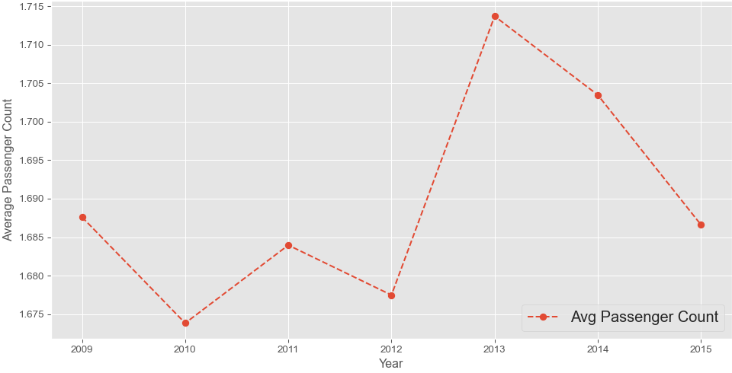
I N S I G H T S
Data Distribution Across Distance Travelled Field
Median Values of Fields

Slide 17
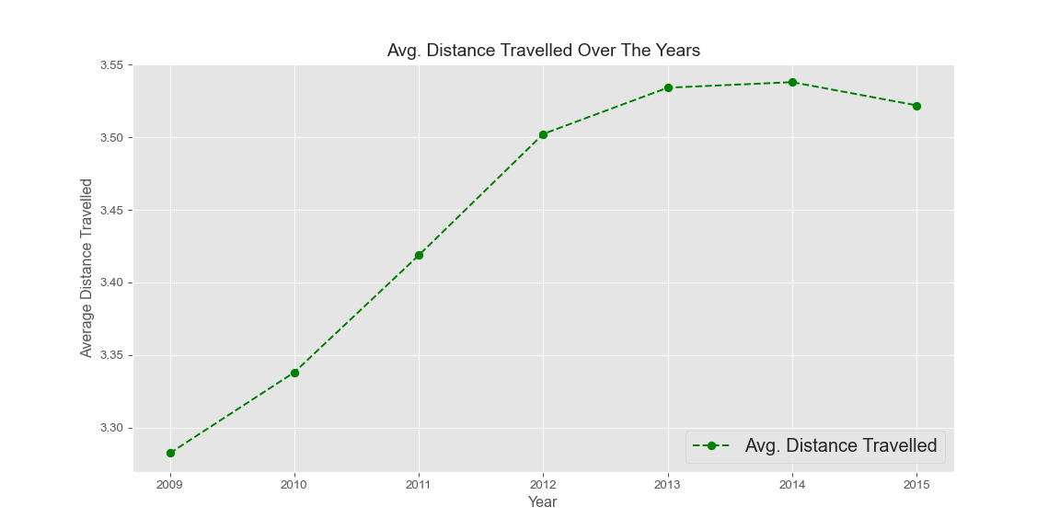
I N S I G H T S
Median Values of Fields
Average No. of Passengers Over the Years

Slide 18
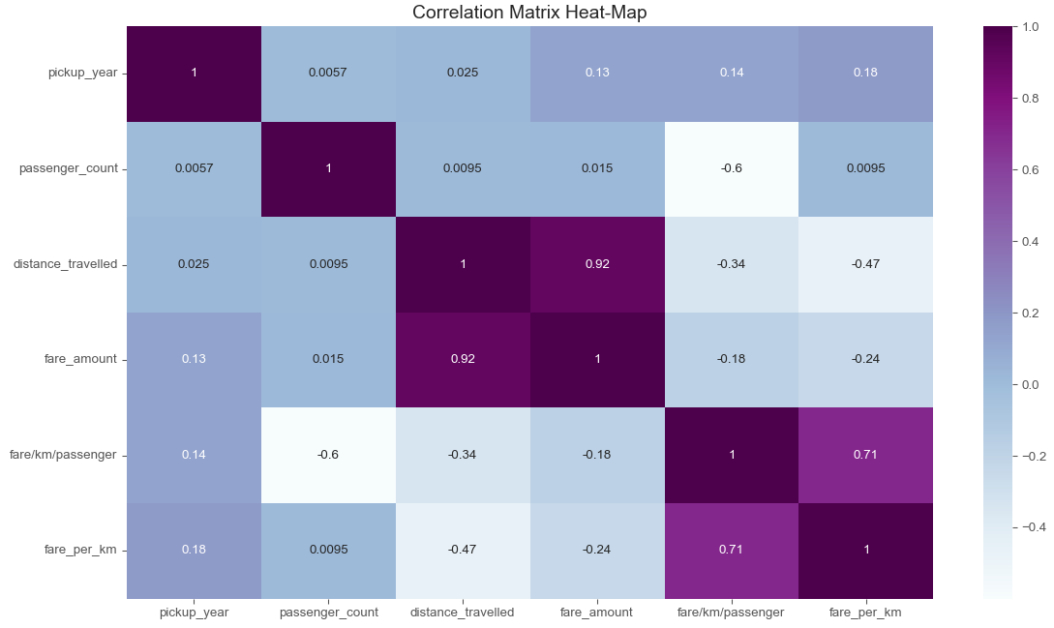
I N S I G H T S
Average No. of Passengers Over the Years

Slide 19
I N S I G H T S
Average No. of Passengers Over the Years
FEATURE SELECTION AND TRAINING

Slide 20
I N S I G H T S
Average No. of Passengers Over the Years
FEATURE SELECTION AND TRAINING

Slide 21
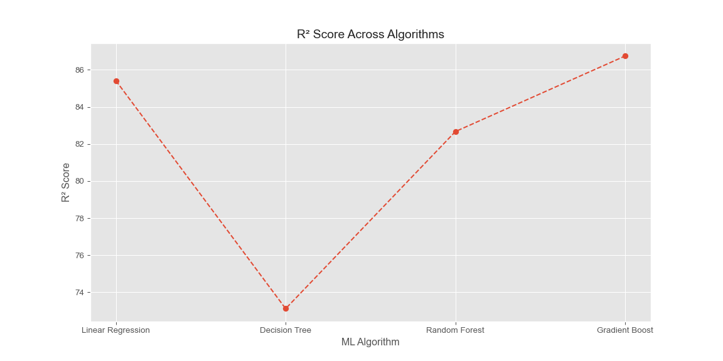
Algorithms Used | R² score
Gradient Boost | 86.75 %
Linear Regression | 85.41 %
Random Forest | 82.67 %
Decision Tree | 73.12 %
I N S I G H T S
The Fields are split for training and testing the algorithms.
Average No. of Passengers Over the Years
Y_Train & Test Field
X_Train and X_Test Fields
pickup_year | passenger_count | distance_travelled | fare_amount | fare/km/passenger | fare_per_km
The test size is 30%.
FEATURE SELECTION AND TRAINING

Slide 22
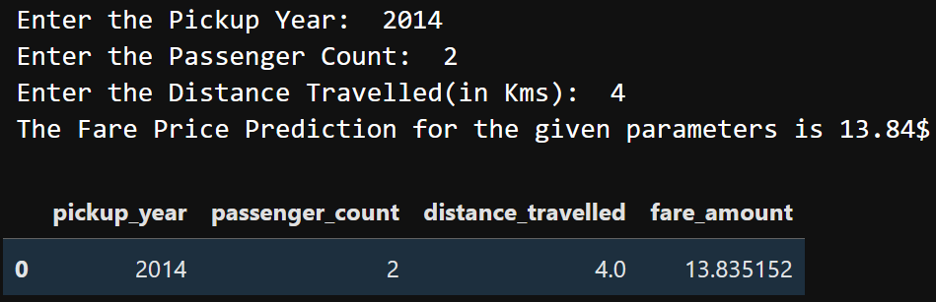
Algorithms Used | R² score
Gradient Boost | 86.75 %
Linear Regression | 85.41 %
Random Forest | 82.67 %
Decision Tree | 73.12 %
I N S I G H T S
Model Deployment:
The Fields are split for training and testing the algorithms.
Average No. of Passengers Over the Years
Y_Train & Test Field
X_Train and X_Test Fields
pickup_year | passenger_count | distance_travelled | fare_amount | fare/km/passenger | fare_per_km
The test size is 30%.
FEATURE SELECTION AND TRAINING

Slide 23
Algorithms Used | R² score
Gradient Boost | 86.75 %
Linear Regression | 85.41 %
Random Forest | 82.67 %
Decision Tree | 73.12 %
I N S I G H T S
Model Deployment:
The Fields are split for training and testing the algorithms.
Average No. of Passengers Over the Years
Y_Train & Test Field
X_Train and X_Test Fields
pickup_year | passenger_count | distance_travelled | fare_amount | fare/km/passenger | fare_per_km
The test size is 30%.
FEATURE SELECTION AND TRAINING

Slide 24
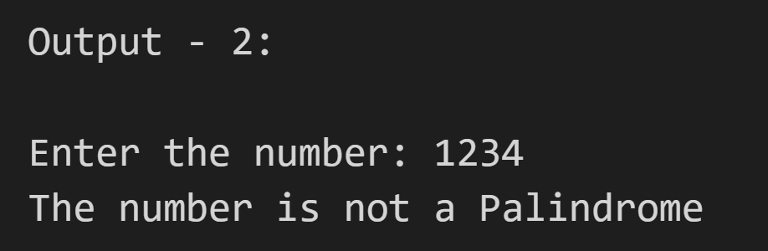
Algorithms Used | R² score
Gradient Boost | 86.75 %
Linear Regression | 85.41 %
Random Forest | 82.67 %
Decision Tree | 73.12 %
O U T P U T
Model Deployment:
T H A N K Y O U

